Slide 1
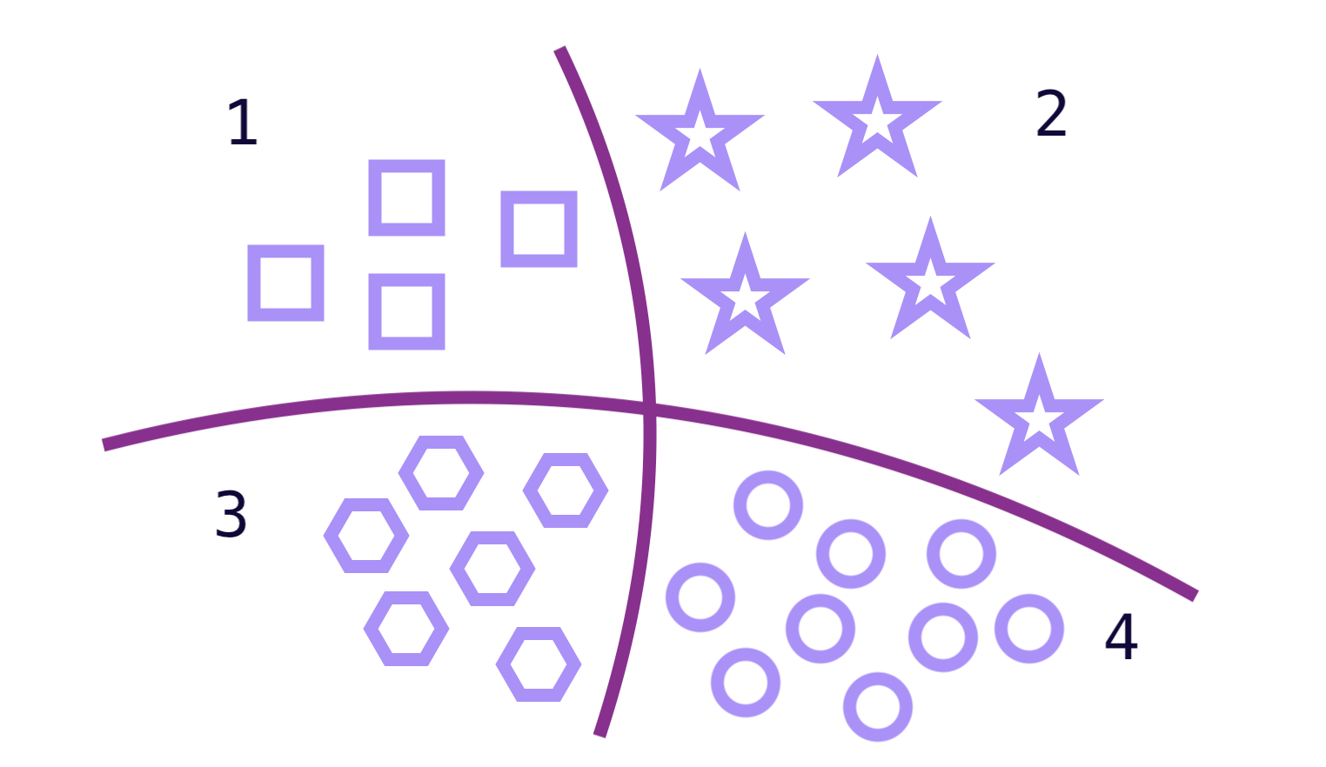
Multi-class Classification

Slide 2
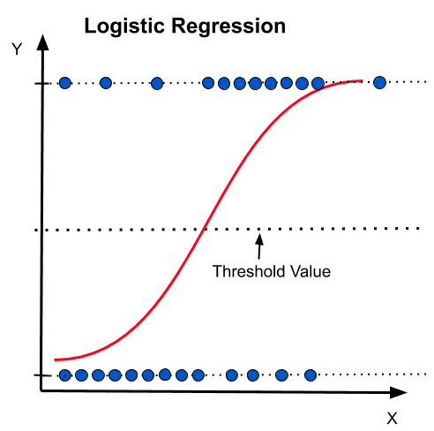














EX:
Passed or not | Number of hours
 | 4
 | 6
 | 2
 | 3
 | 10
 | 7
 | 5
1
0

Slide 3
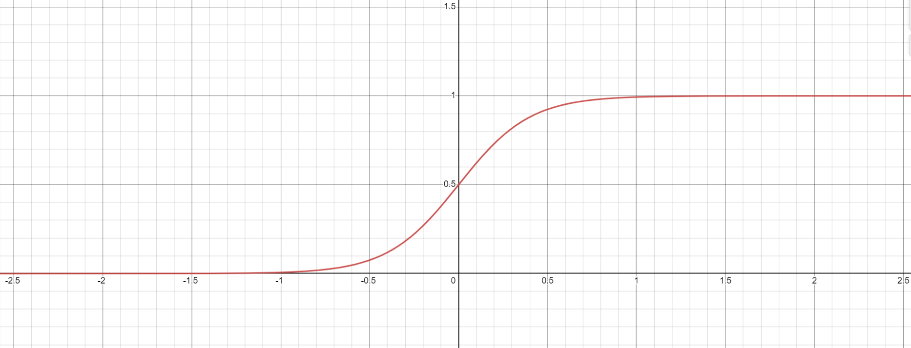
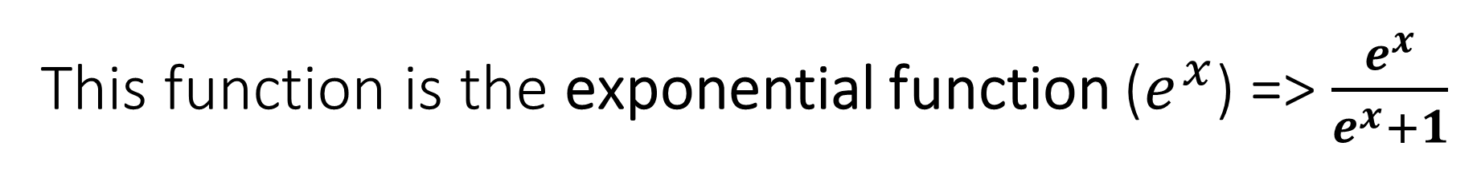
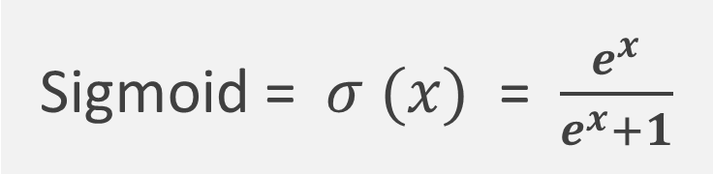
This function is the exponential function ($e^{x}$) => $\frac{e^{x}}{e^{x}+1}$
Sigmoid = $σ (x)$ = $\frac{e^{x}}{e^{x}+1}$

Slide 4
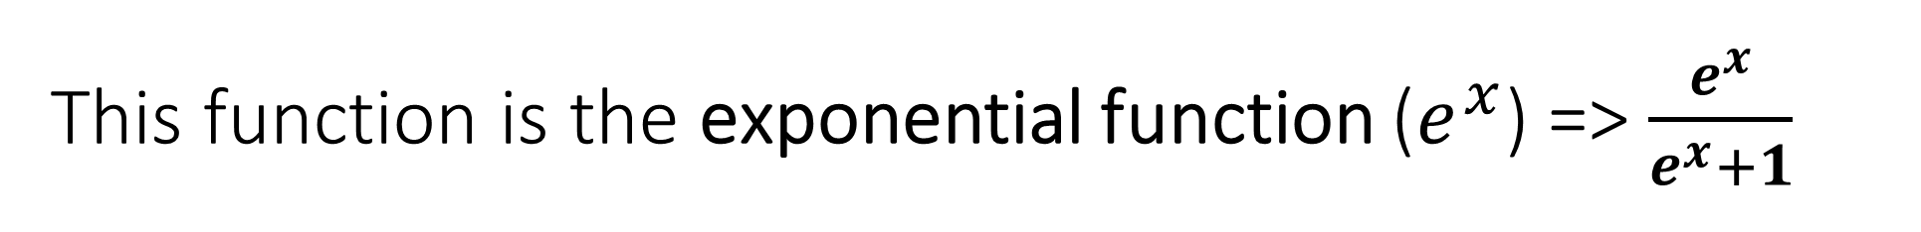
This function is the exponential function ($e^{x}$) => $\frac{e^{x}}{e^{x}+1}$

Slide 5

Let’s take another example

Slide 6




Cat - Dog classification
Cat
Dog
Cat
Dog

Slide 7
Cat - Dog classification
Cat
Y = 0
Dog
Y = 1
Cat
Y = 0
Dog
Y =1

Slide 8
Cat - Dog classification
Cat
Y = 0
Dog
Y = 1
Cat
Y = 0
Dog
Y =1
We can use also the sigmoid function

Slide 9
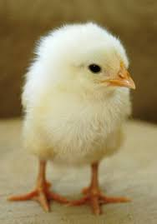

What about this ?!
Cat
Y = 0
Baby chicken
Y = 2
Dog
Y = 1
Cat
Y = 0
Baby chicken
Y = 2
Dog
Y =1

Slide 10
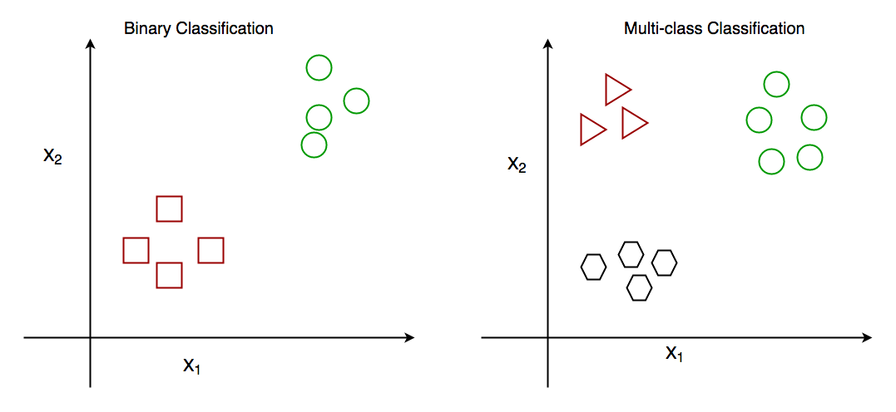

Slide 11


Slide 12
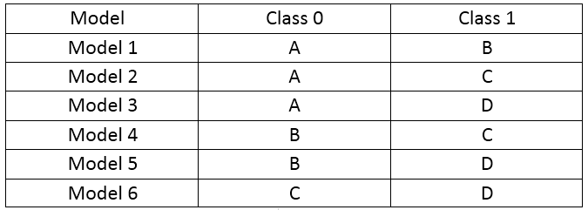

Slide 13
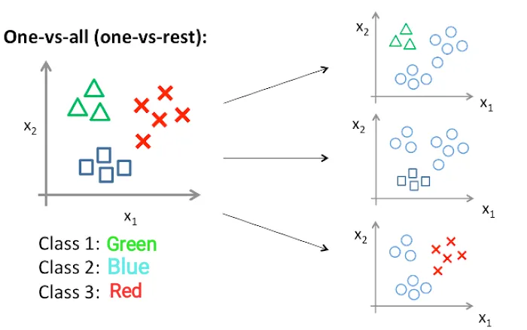
One-vs-all (one-vs-rest)

Slide 14
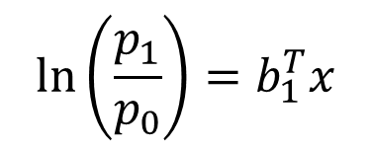
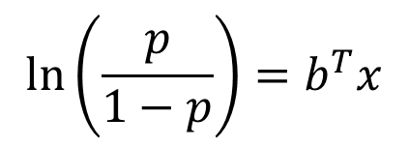
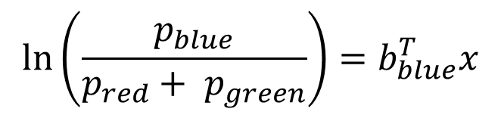
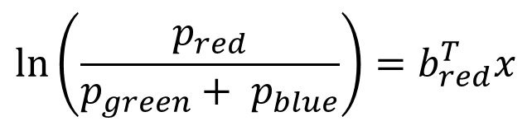
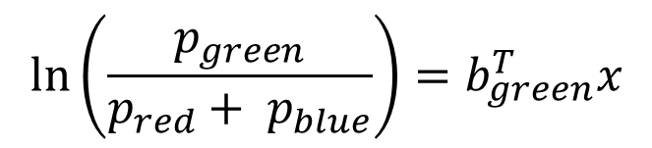
One-vs-all (one-vs-rest)
$$\ln\left(\frac{p}{1−p}\right)=b^{T}x$$
$$\ln\left(\frac{p_{1}}{p_{0}}\right)=b_{1}^{T}x$$
$$\ln\left(\frac{p_{green}}{p_{red}+ p_{blue}}\right)=b_{green}^{T}x$$
$$\ln\left(\frac{p_{red}}{p_{green}+ p_{blue}}\right)=b_{red}^{T}x$$
$$\ln\left(\frac{p_{blue}}{p_{red}+ p_{green}}\right)=b_{blue}^{T}x$$

Slide 15
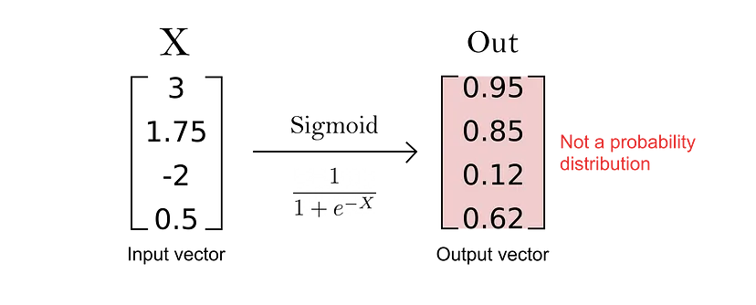
The output is not a probability distribution because there no relationship between them (because the denominator is variable). So we can’t apply sigmoid

Slide 16
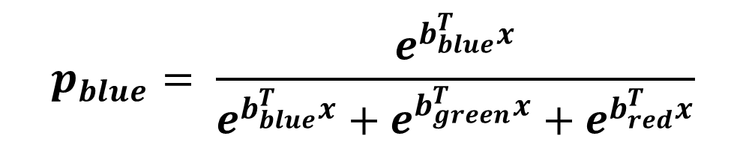
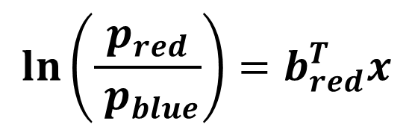
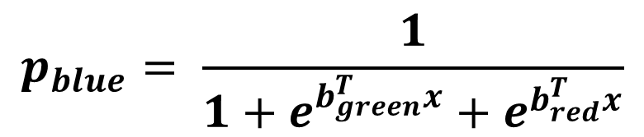

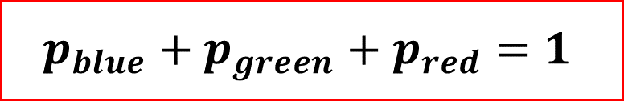
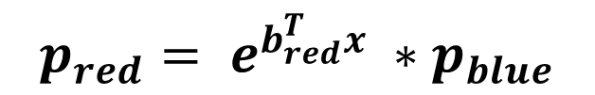

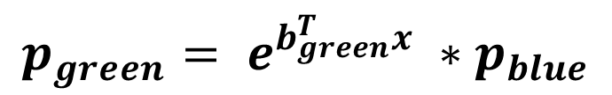
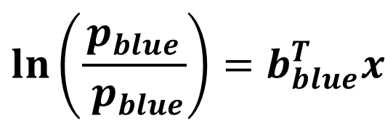
So, we will choose one class to be our pivot class
$$\ln\left(\frac{p_{blue}}{ p_{blue}}\right)=b_{blue}^{T}x$$
$$\ln\left(\frac{p_{green}}{p_{blue}}\right)=b_{green}^{T}x$$
$$\ln\left(\frac{p_{red}}{ p_{blue}}\right)=b_{red}^{T}x$$
$$p_{green}= e^{b_{green}^{T}x} ∗p_{blue}$$
$$p_{red}= e^{b_{red}^{T}x} ∗p_{blue}$$
$$b_{blue}^{T}x=0$$
$$p_{blue}+p_{green}+p_{red}=1$$
$∴$ $p_{blue}+e^{b_{green}^{T}x} ∗p_{blue}+e^{b_{red}^{T}x} ∗p_{blue}=1$
$$p_{blue}= \frac{e^{b_{blue}^{T}x}}{e^{b_{blue}^{T}x}+e^{b_{green}^{T}x}+e^{b_{red}^{T}x}}$$
$$p_{blue}= \frac{1}{1+e^{b_{green}^{T}x}+e^{b_{red}^{T}x}}$$

Slide 17
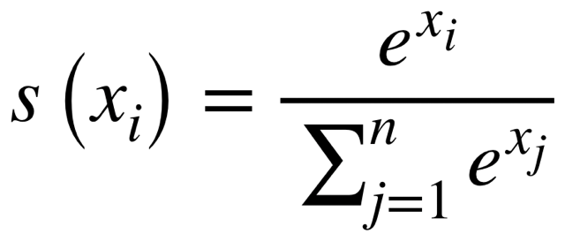
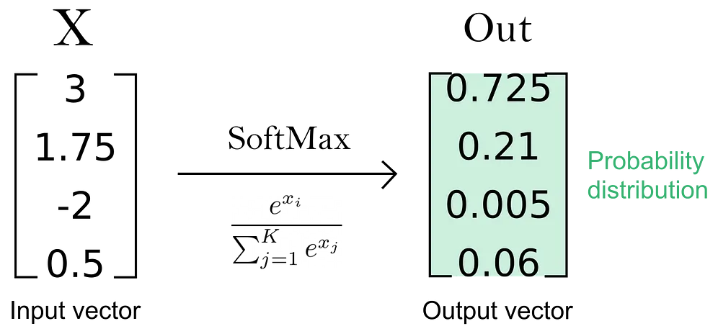
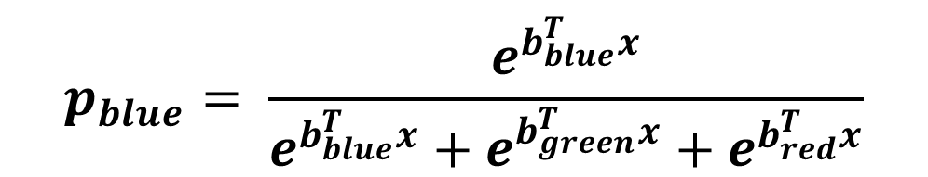
( Softmax function )
$$p_{blue}= \frac{e^{b_{blue}^{T}x}}{e^{b_{blue}^{T}x}+e^{b_{green}^{T}x}+e^{b_{red}^{T}x}}$$

Slide 18
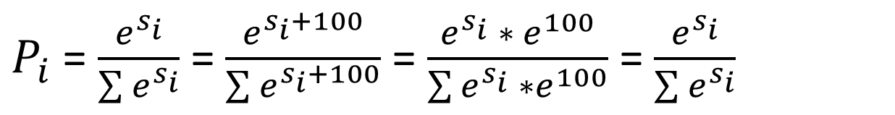
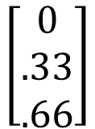

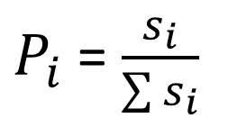
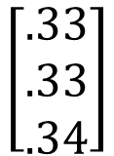
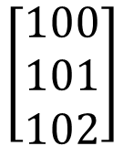
IDEA 1
x
p
x
p
$$\left[\begin{aligned}0 \\ 1 \\ 2\end{aligned}\right]$$
$$\left[\begin{aligned}0 \\ .33 \\ .66\end{aligned}\right]$$
$$\left[\begin{aligned}100 \\ 101 \\ 102\end{aligned}\right]$$
$$\left[\begin{aligned}.33 \\ .33 \\ .34\end{aligned}\right]$$
$P_{i}$ = $\frac{s_{i}}{\sum{s_{i}}}$
Which means if we add constant to all score ($b^{T}x+100 ) it changes the probailty$
IDEA 2
$P_{i}$ = $\frac{e^{s_{i}}}{\sum{e^{s_{i}}}}$ = $\frac{e^{s_{i}+100}}{\sum{e^{s_{i}+100}}}$ = $\frac{e^{s_{i}} ∗ e^{100}}{\sum{e^{s_{i}} ∗e^{100}}}$ = $\frac{e^{s_{i}}}{\sum{e^{s_{i}}}}$

Slide 19
Let’s derive the cost function

Slide 20
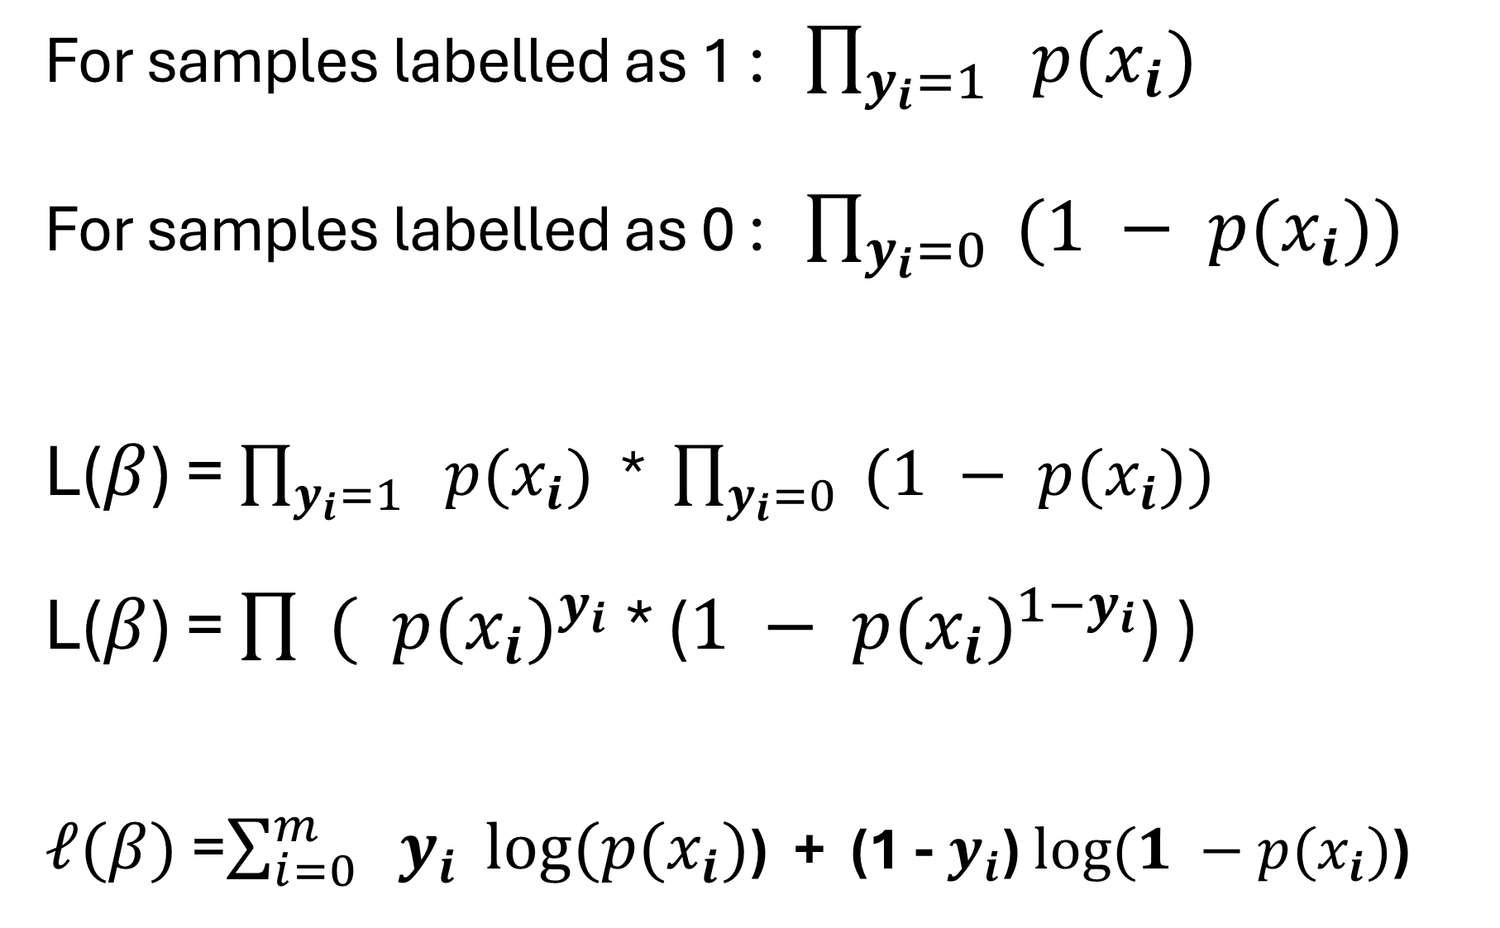
For samples labelled as 1 : $\prod_{y_{i}=1}{ p(x_{i})}$ For samples labelled as 0 : $\prod_{y_{i}=0}{ (1 − p(x_{i}))}$ L($β$) = $\prod_{y_{i}=1}{ p(x_{i})}$ * $\prod_{y_{i}=0}{ (1 − p(x_{i}))}$ L($β$) = $\prod{ ( {p(x_{i})}^{y_{i}}}$ * ($1 − {p(x_{i})}^{1−y_{i}}$) ) $ℓ(β)$ =$\sum_{i=0}^{m}{ y_{i}} log⁡(p(x_{i})$) + (1 - $y_{i}$) $log⁡(1 −p(x_{i})$)

Slide 21
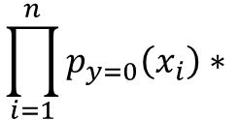


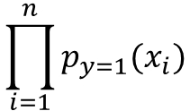

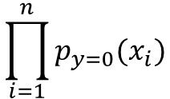
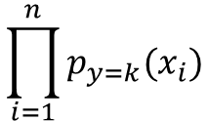
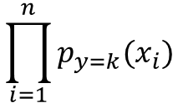

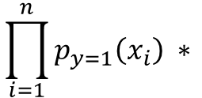
For samples labeled as 0:
$$\prod_{i=1}^{n}{p_{y=0}(x_{i})}$$
$\left(P_{y=0} | X\right)$ =
For samples labeled as 1:
$$\prod_{i=1}^{n}{p_{y=1}(x_{i})}$$
$\left(P_{y=1} | X\right)$ =
For samples labeled as k:
$$\prod_{i=1}^{n}{p_{y=k}(x_{i})}$$
$\left(P_{y=k} | X\right)$ =
$$\prod_{i=1}^{n}{p_{y=0}\left(x_{i}\right)∗ }$$
$$\prod_{i=1}^{n}{p_{y=1}\left(x_{i}\right) ∗ }$$
$$\prod_{i=1}^{n}{p_{y=k}(x_{i})}$$
$\left(p_{y} | X\right)$ =

Slide 22
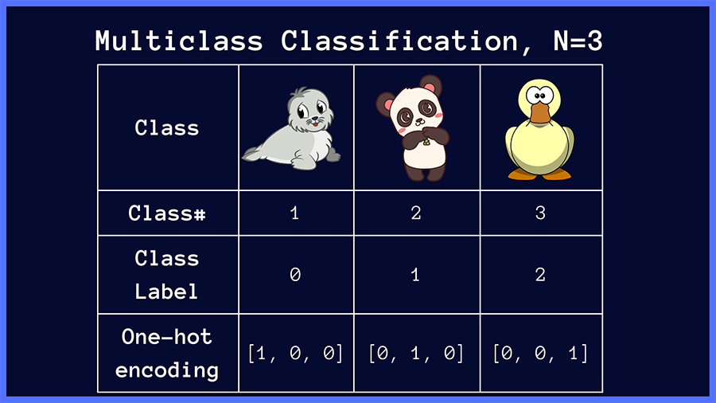

Slide 23
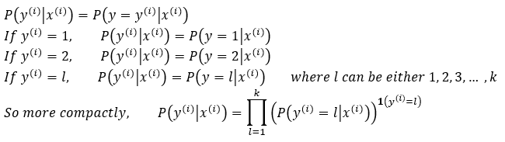
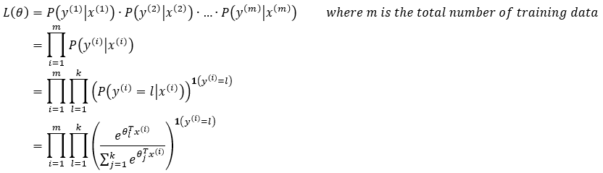

Slide 24
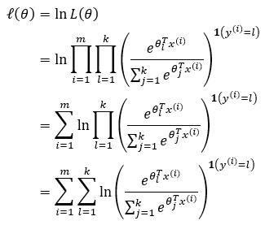
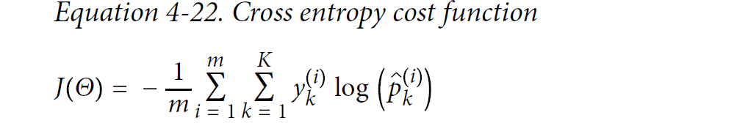

Slide 25
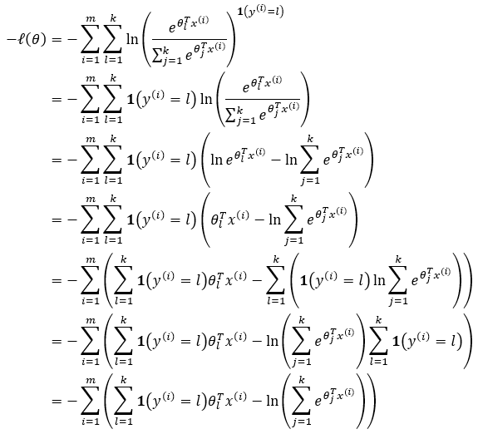
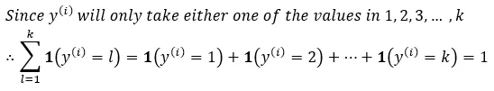

Slide 26
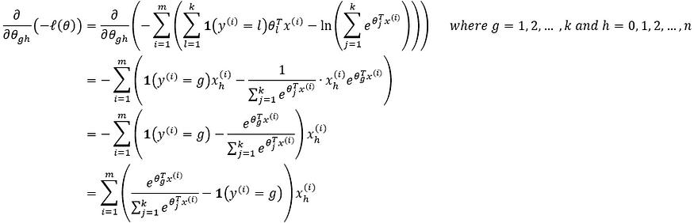
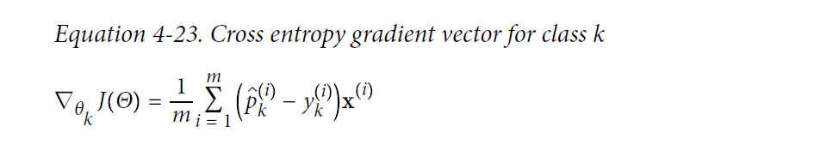


Slide 28
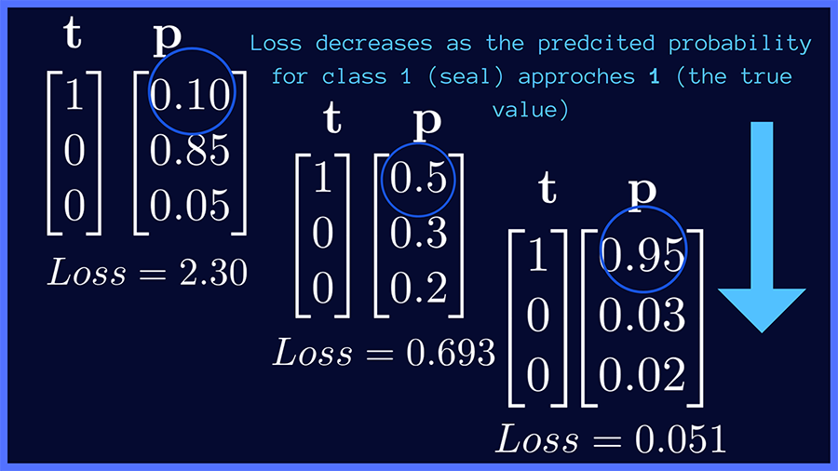

Slide 29
Thank you !

